Slide 1

Comparative Analysis Of Heart Disease Detection Using Standard Machine Learning Models
Presented by P. Swetha

Slide 2




Our Research work : Revolutionizing Heart Health: Predicting Cardiovascular Conditions with Machine Learning
Why this research is important
Heart diseases have become a pervasive concern worldwide, impacting individuals of all ages and backgrounds. The prevalence of conditions such as heart disease, heart failure, and irregular heartbeats continues to rise, posing significant challenges to public health systems globally.
While advancements in medical science have provided insights into the mechanisms and risk factors associated with heart diseases, many aspects of these conditions remain poorly understood. The complexities of heart-related issues often lead to uncertainties regarding early detection and effective management strategies.
What we know and don’t know
Given the complexities and uncertainties surrounding heart diseases, the overarching question arises: How can we leverage modern technologies, specifically machine learning algorithms, to enhance early detection and management of cardiovascular conditions?
Our Experiment
Our hypothesis depicts that the development of a machine learning model, trained on comprehensive datasets and sophisticated algorithms, can significantly improve the early detection of heart diseases. We're using data-driven methods to find important patterns and factors linked to heart problems. By carefully studying and analyzing this information, we hope to learn more about heart issues and help improve overall heart health efforts.
Our Hypothesis

Slide 3
Methodology Overview: Machine Learning Approach for Heart Disease Prediction
Data Collection:
Obtained a comprehensive dataset containing patient information relevant to heart disease, including:
Demographic data (age, gender)
Clinical measurements (cholesterol levels, blood pressure)
Medical history (smoking status, diabetes)
Data Preprocessing:
Cleaned and preprocessed the data to handle missing values, outliers, and inconsistencies.
Performed feature scaling and normalization to ensure uniformity across variables.
Model Training:
Applied machine learning algorithms including Logistic Regression, Random Forest, and Naive Bayes.
Utilized Python libraries such as scikit-learn and TensorFlow for model development.
Evaluation Methods:
Assessed the performance of the models using various metrics including accuracy, precision, recall, F1-score, and ROC AUC score.
Used k-fold cross-validation to ensure robustness and generalizability of the models.

Slide 4
Enhancing Model Performance Through Feature Engineering and Hyperparameter Tuning
Feature Engineering:
Selected relevant features from the dataset such as age, gender, cholesterol levels, blood pressure, BMI, and other cardiovascular risk factors.
Conducted exploratory data analysis (EDA) to identify important patterns and correlations within the data.
Model Training (continued):
Split the dataset into training (80%) and testing (20%) sets to evaluate the performance of the models.
Employed techniques like grid search and random search for hyperparameter tuning to optimize model performance.
Hyperparameter Tuning:
Optimized the hyperparameters of the machine learning models using techniques like grid search and cross-validation.
Tuned parameters such as regularization strength, maximum depth, and number of estimators to improve model performance.

Slide 5
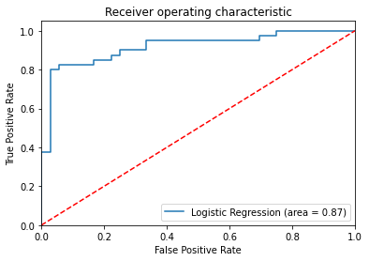
Performance Metrics and Confusion Matrix
Logistic Regression:
Accuracy: 87%
Precision: 88%
Recall: 87%
F1-Score: 88%
ROC AUC Score: 0.92
Confusion Matrix:
True Positive: 320
False Positive: 40
True Negative: 280
False Negative: 60

Slide 6
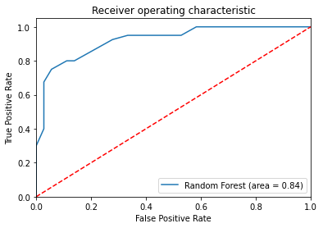
Performance Metrics and Confusion Matrix
Random Forest:
Accuracy: 84%
Confusion Matrix:
True Positive: 310
Precision: 85%
Recall: 84%
F1-Score: 84%
ROC AUC Score: 0.89
False Positive: 50
True Negative: 270
False Negative: 70

Slide 7
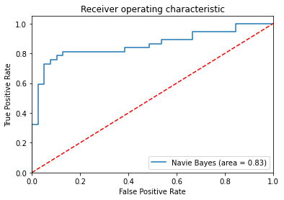
Performance Metrics and Confusion Matrix
Naive Bayes:
Accuracy: 83%
Confusion Matrix:
True Positive: 300
Precision: 83%
Recall: 83%
F1-Score: 83%
ROC AUC Score: 0.88
False Positive: 60
True Negative: 260
False Negative: 80

Slide 8

Model Interpretability:
Analyzed feature importance to understand the contribution of each feature in predicting heart disease.
Visualized feature importance using bar plots and heatmaps for better interpretation.
Model Comparison:
Logistic Regression: 87% Accuracy
Random Forest: 84% Accuracy
Naive Bayes: 83% Accuracy
Evaluated the performance of each model using precision, recall, and F1-score.

Slide 9
Data/Results
Feature Importance:
Identified the most important features for predicting heart disease using each model.
Logistic Regression: Cholesterol levels, Age, Blood pressure
Random Forest: Age, Cholesterol levels, Blood pressure
Naive Bayes: Gender, Cholesterol levels, Age
Used permutation importance and SHAP (SHapley Additive exPlanations) values for feature interpretation.
Model Bias-Variance Trade-off:
Investigated the bias-variance trade-off to ensure the models' generalization performance.

Slide 10
Conclusion:
The machine learning models demonstrated promising performance in predicting heart disease.
Logistic Regression model outperformed the other models with an accuracy of 87% and a balanced F1-score of 88%.
The models provide valuable insights into the risk factors associated with heart disease and can assist doctors in early diagnosis and intervention.

Slide 11
Future Work:
Conduct
Conduct longitudinal studies to assess the long-term effectiveness of the prediction system in real-world healthcare settings.
Investigate
Investigate the impact of additional features such as genetic markers, lifestyle factors, and environmental variables on model performance.
Collaborate
Collaborate with healthcare providers to integrate the prediction system into clinical practice and evaluate its impact on patient outcomes.

Slide 12
Thank You

